Slide 1

GeoParquet and GeoArrow in deck.gl
Performant, interoperable rendering of large data
Kyle Barron
Cloud Engineer @ Development Seed

Slide 2
Motivation
Why deck.gl?
GeoParquet and GeoArrow
Implementation status & Future work

Slide 3
Motivation

Slide 4
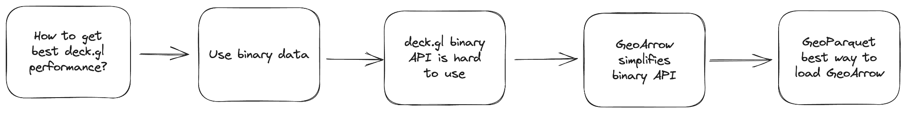
deck.gl at the center of motivation
Last year’s talk layout
Notes:
Last year I put deck.gl at the center of why this matters
Slightly different tack than last year
Last year put deck.gl at the center

Slide 5
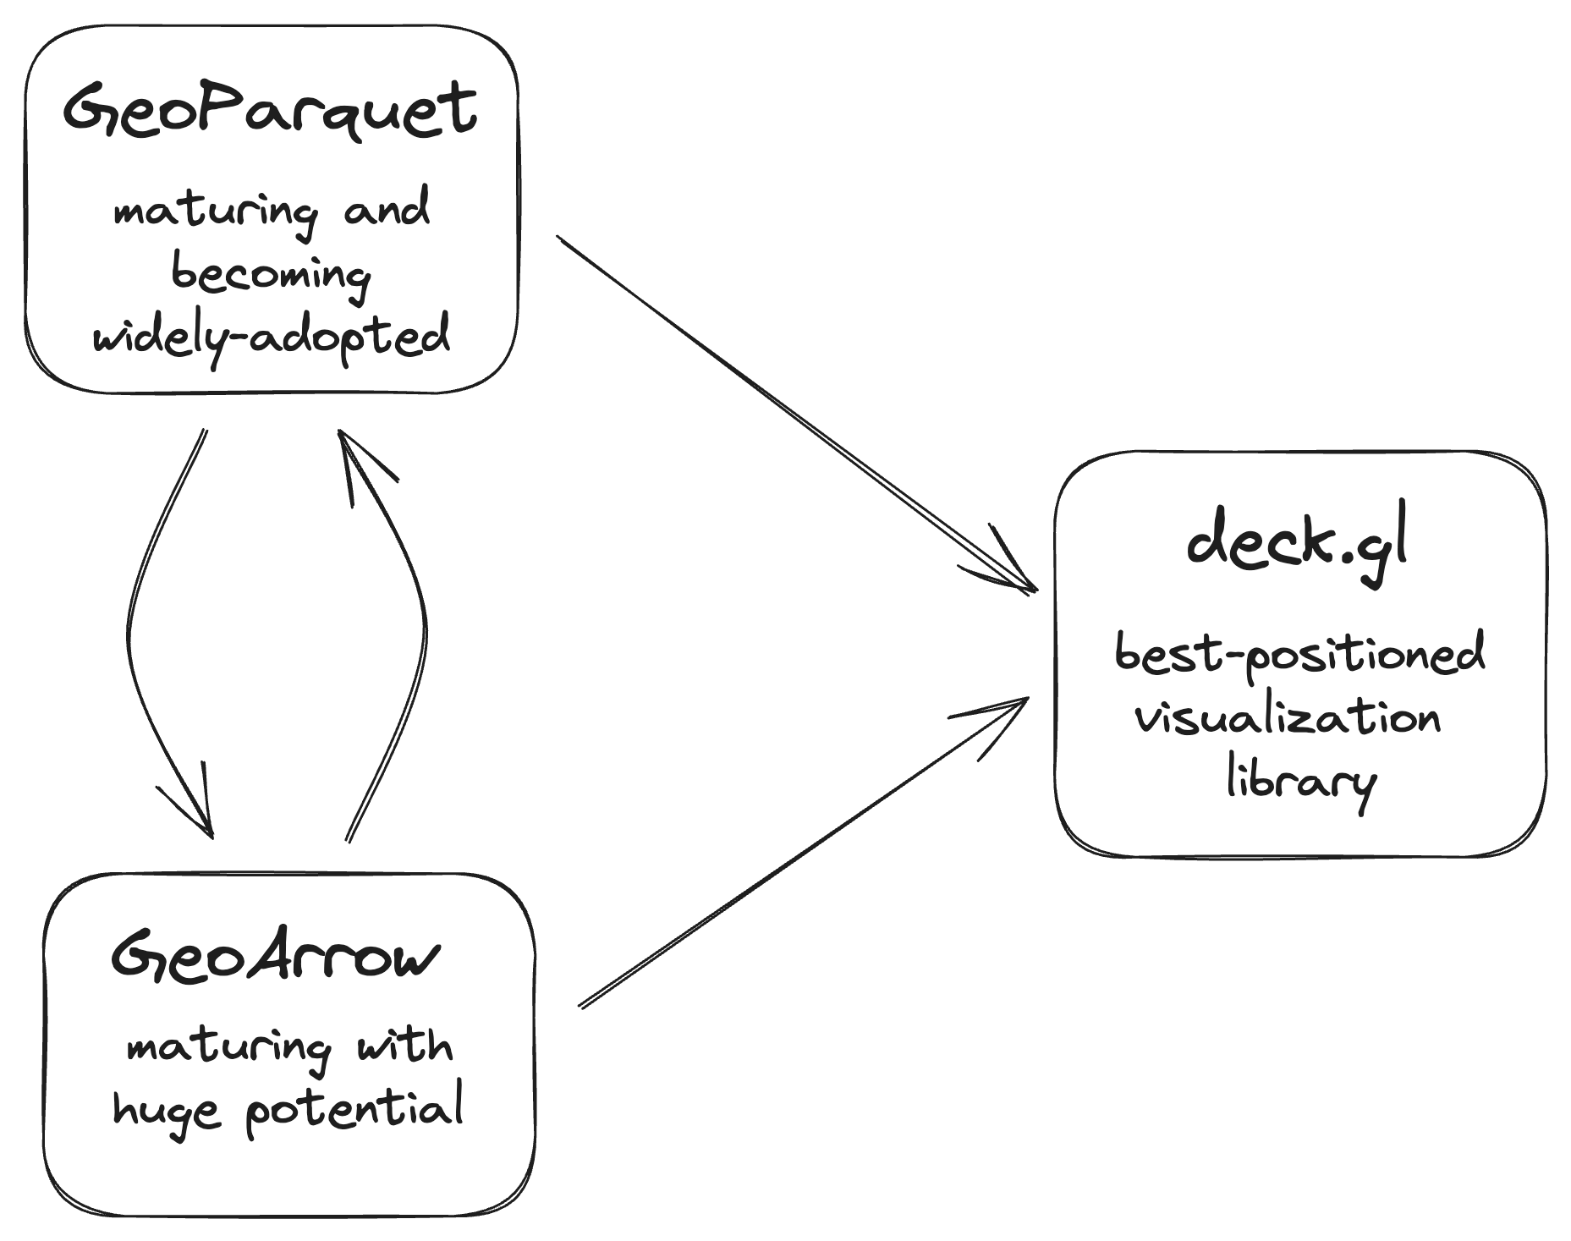
GeoParquet and GeoArrow as their own rationale
This talk’s layout
Notes:
Motivating the talk in the reverse direction
My goal is to:
Introduce GeoParquet and GeoArrow
Show that they can already be used efficiently with deck.gl’s binary API
Convince developers that a more user-friendly GeoArrowLayer is useful
GeoParquet and GeoArrow have matured a lot
The future of geospatial data analysis in their own right
I argue that both will revolutionize geospatial data processing
Deck.gl is the best-positioned visualization library to take advantage of this wave

Slide 6
GeoParquet
Efficient file format for geospatial vector data

Slide 7
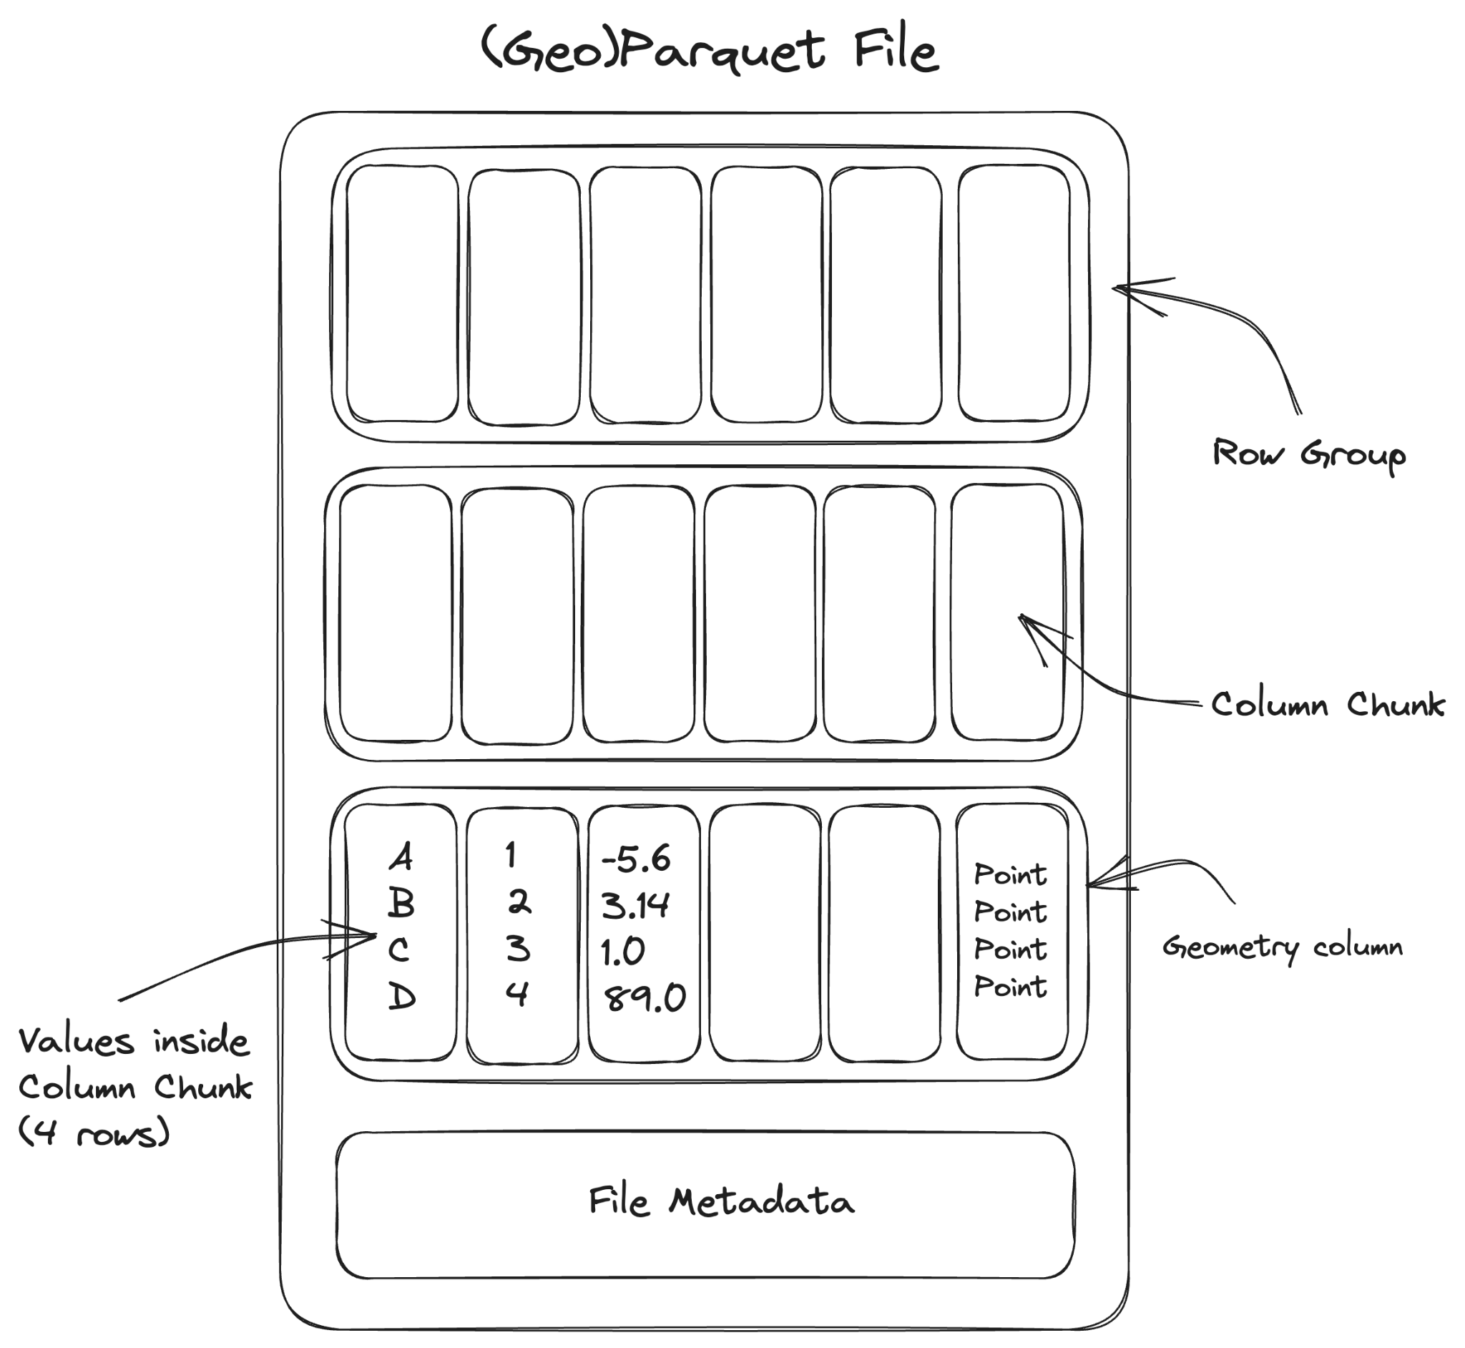
De-facto columnar file format for tabular data
Apache Parquet
Chunked, columnar data format
Extensive type system, including nested types
Extremely efficient compression
Implementations in JS (Wasm), Python, C, Java, Rust, etc.
Widely adopted
Snowflake, BigQuery, RedShift, Databricks
Hadoop, Spark, DuckDB
Pandas, Polars, Velox, DataFusion
Originated in 2013 with Hadoop

Slide 8
Geospatial support for Parquet
GeoParquet
Extends Parquet for geospatial data
Readable by non-geospatial tools
Cloud-native: read chunks of file efficiently via HTTP range requests
Use the same data files for backend analysis and frontend visualization
Increasing adoption:
GeoPandas, QGIS, Apache Sedona, GDAL
Future work: spatial partitioning
Specification at 1.0.0-rc.1

Slide 9
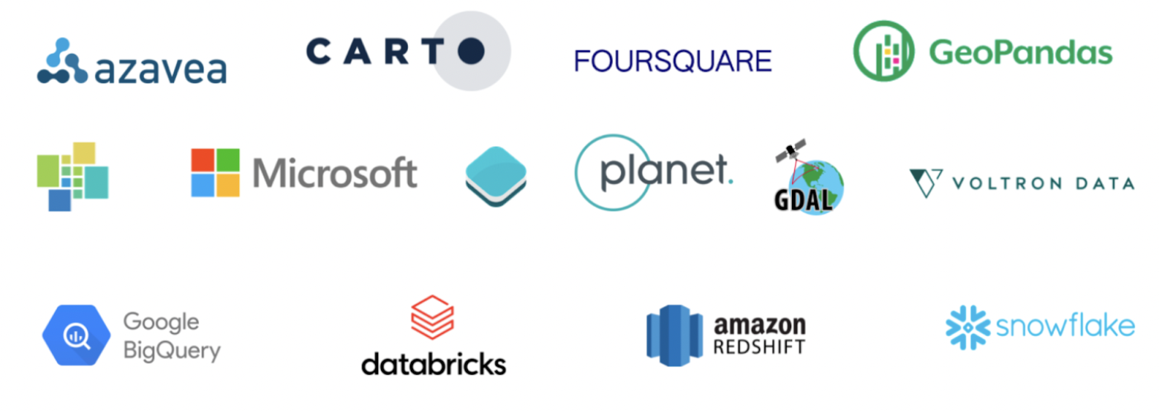
GeoParquet developed by broad community

Slide 10
GeoArrow
Enabling zero-copy data sharing for geospatial

Slide 11
Enabling zero-copy data sharing for scientific Python libraries
Python Buffer Protocol (2006)
Problem: Expensive to copy & convert array data between Python libraries
Solution: Protocol for zero-copy sharing of multi-dimensional array data
Enabled widespread innovation on top of NumPy (v1.0 in 2006)
“This cannot be emphasized enough: it is fundamentally the Buffer Protocol and related NumPy functionality that make Python useful as a scientific computing platform.”
- Jake VanderPlas (An Introduction to the Python Buffer Protocol, 2014)

Slide 12
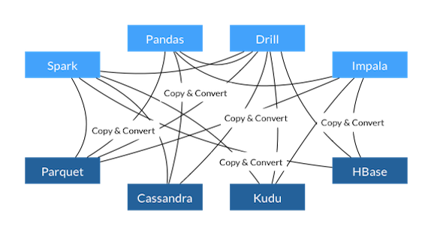
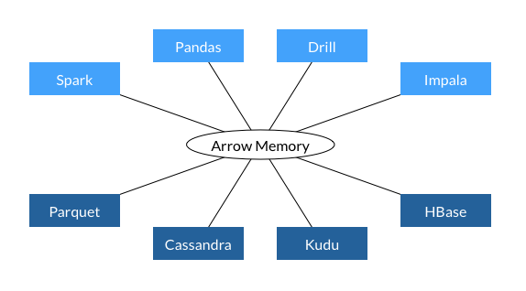
Before Arrow
Enabling zero-copy data sharing for tabular libraries
Apache Arrow (2015)
With Arrow
Problem:
Pandas library for tabular data implemented on top of NumPy
Expensive to copy & convert tabular data between languages
Solution:
Protocol for language-independent zero-copy sharing of columnar tabular data
Extensive type system, including nested types
Become the standard memory format for modern analytical tools:
Pandas, Polars, Velox, DuckDB, DataFusion, R, cuDF
Loading a Parquet file gives you Arrow memory
Notes:
Motivating the talk in the reverse direction
DuckDB can operate on Python Arrow tables without copy

Slide 13
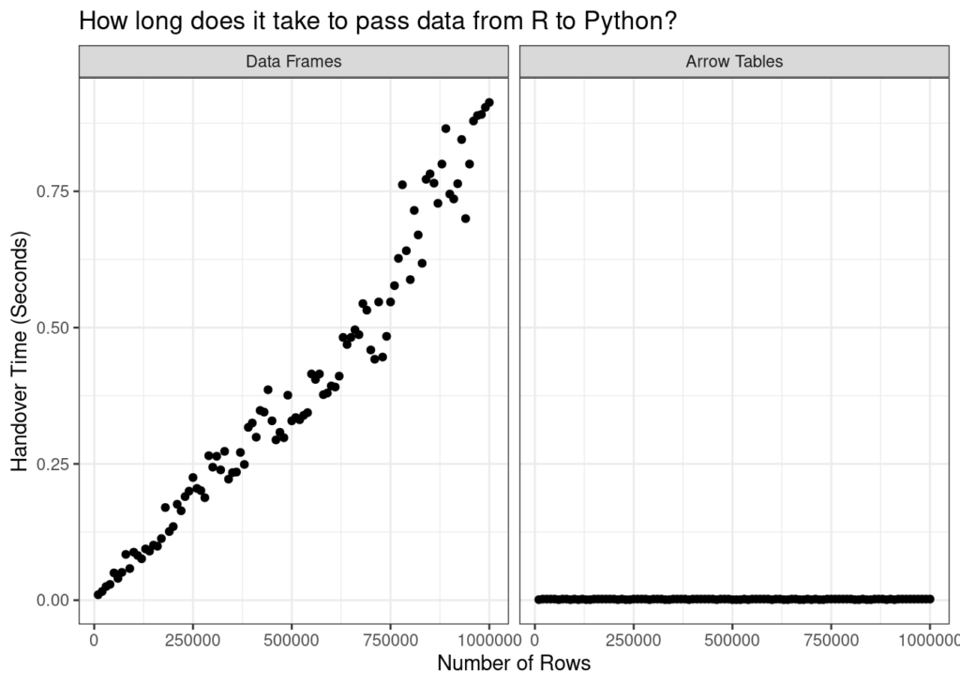
Enabling zero-copy data sharing for tabular libraries
Apache Arrow (2016)
Data movement is always O(1)
Danielle Navarro (Passing Arrow data between R and Python with reticulate)
Notes:
Motivating the talk in the reverse direction
DuckDB can operate on Python Arrow tables without copy

Slide 14
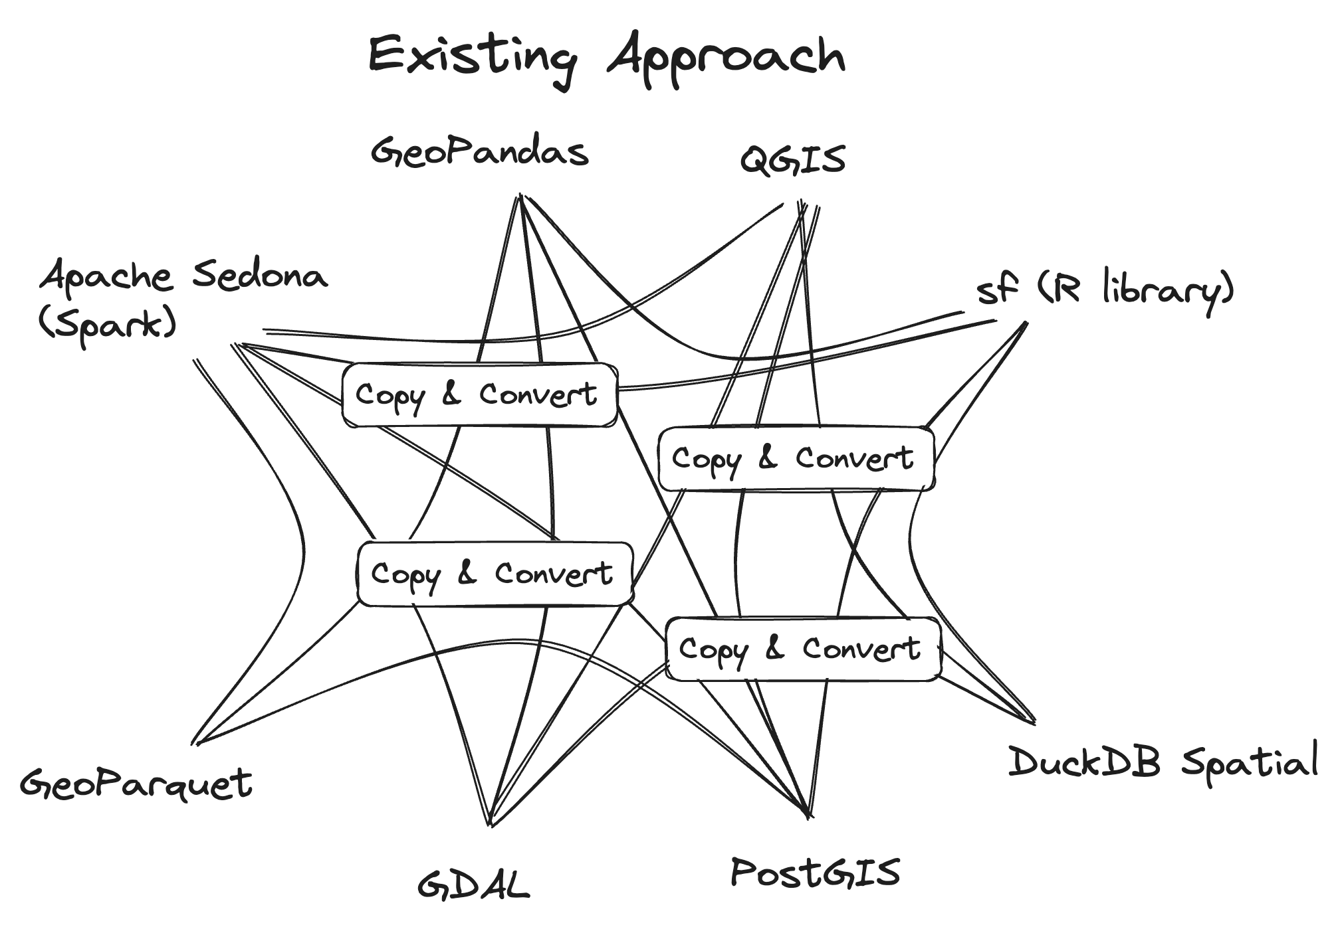
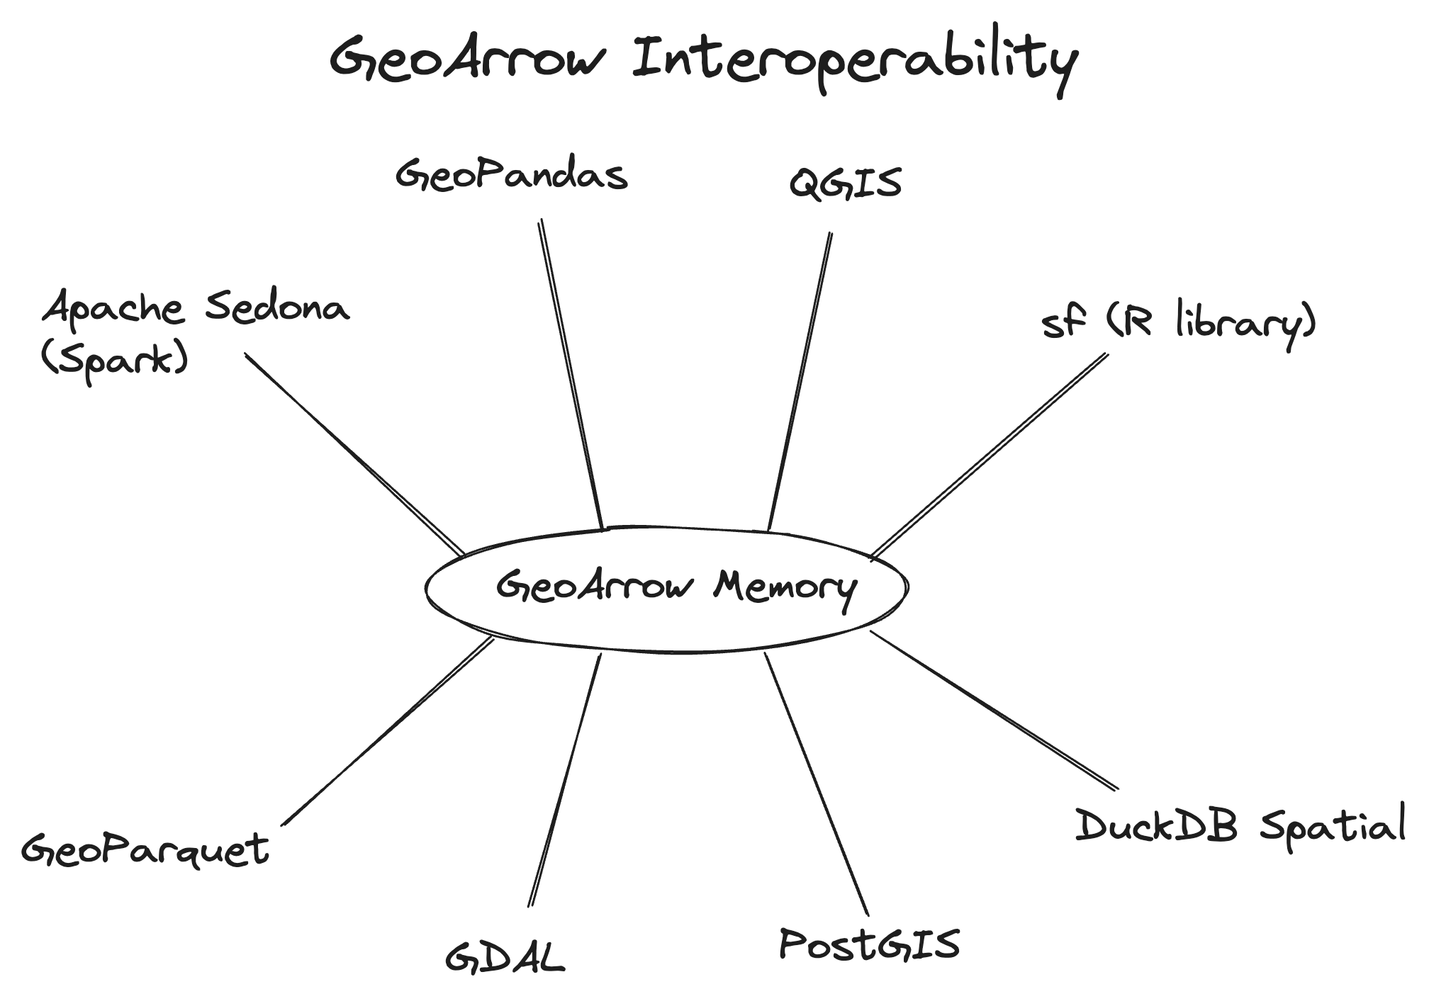
Enabling zero-copy data sharing for geospatial
GeoArrow (2020-)
Problem:
Expensive to copy & convert geospatial tabular data between systems
Python __geo_interface__ protocol exists but GeoJSON serialization is slow
Solution:
Protocol for language-independent zero-copy sharing of geospatial tabular data
Defines storage of vector geospatial data in Apache Arrow
Full Arrow type system available for attributes
Progress towards wide adoption:
GDAL RFC 86: Load any GDAL-supported vector format as a GeoArrow table.
Integrated into GeoPandas, DuckDB Spatial, cuSpatial
Loading a GeoParquet file gives you GeoArrow memory
Notes:
Motivating the talk in the reverse direction

Slide 15
Why deck.gl?
Uniquely-positioned to take advantage of GeoParquet and GeoArrow

Slide 16
Bandwidth is the browser's limiting factor for large data
Why deck.gl + GeoParquet?
Bandwidth is the browser's limiting factor for large data
Efficient compression: Parquet files are much smaller than comparable formats
Partitioning: Fetch only the requested columns/chunks of file
Spatial partitioning a future addition to GeoParquet spec
Cloud-native support: Fetch parts of the same files used for backend analytics
Notes:
Motivating the talk in the reverse direction

Slide 17
deck.gl’s binary API generally compatible with GeoArrow
Why deck.gl + GeoArrow?
ScatterplotLayer
Attributes
Buffer Layout
instancePositions
instanceRadius
instanceFillColors
instanceLineColors
instanceLineWidth
[x0, y0, z0, x1, y1, z1, …]
[r0, r1, …]
[R0, G0, B0, A0, R1, G1, B1, A1, …]
[R0, G0, B0, A0, R1, G1, B1, A1, …]
[w0, w1, …]
Slide from deck.gl Technical Deep Dive (Xiaoji Chen)

Slide 18
Enabling zero-copy data sharing for geospatial
Why deck.gl + GeoArrow?
Existing prioritization of large data rendering
Existing columnar binary data API
Investing in next-generation technologies like WebGPU
deck.gl’s binary API generally compatible with GeoArrow
ScatterplotLayer: GeoArrow PointArray
PathLayer: GeoArrow LineStringArray
PolygonLayer: GeoArrow PolygonArray
Notes:
Motivating the talk in the reverse direction

Slide 19
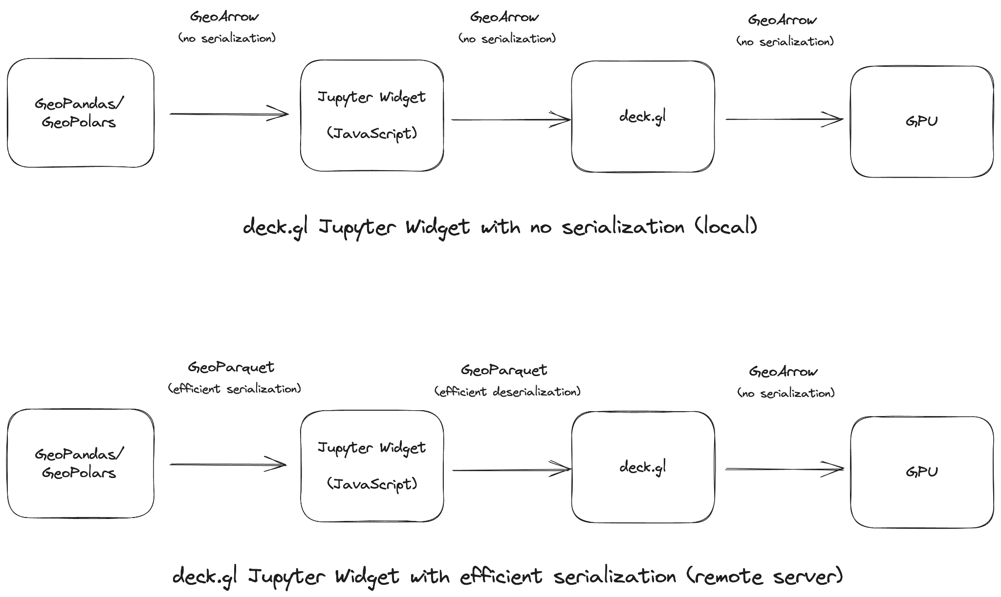
Python rendering with no serialization
Use Case: GeoArrow Jupyter Widget

Slide 20
Implementation status &
Future work

Slide 21
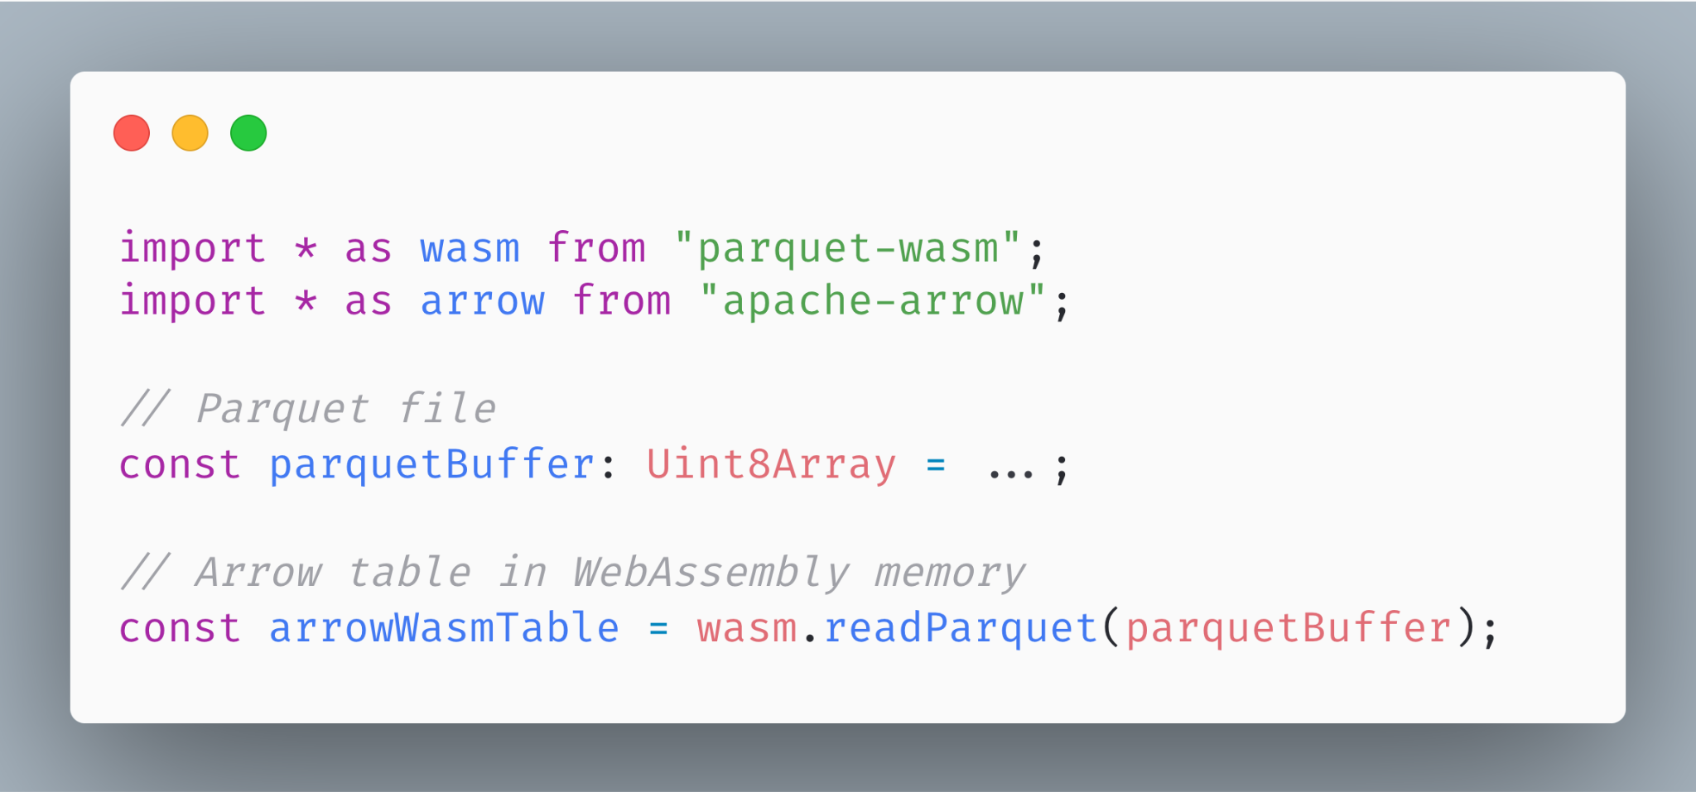
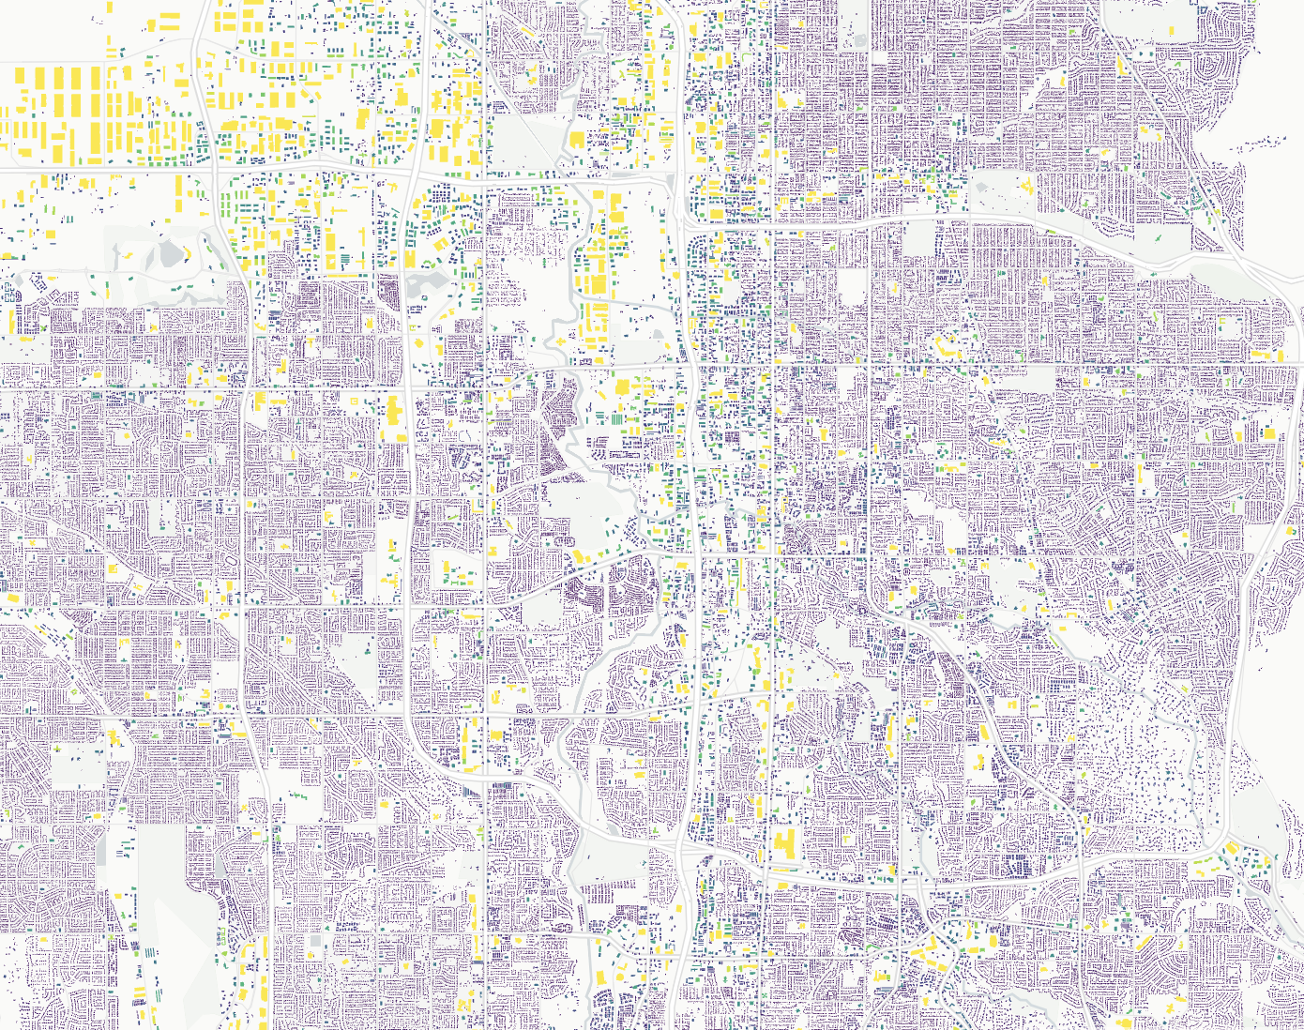
Fast, stable Parquet reading
parquet-wasm
WebAssembly (Rust) implementation of reading and writing Parquet
GeoParquet file with 1M buildings (7M coords) parses in 1.3 seconds (mac pro 14” 2023)
Wasm bundle size:
309kb (no compressions)
741kb (all compressions)
961kb (all compressions + async support)
https://observablehq.com/@kylebarron/prototyping-georust-geoarrow-in-webassembly
Notes:
Motivating the talk in the reverse direction

Slide 22
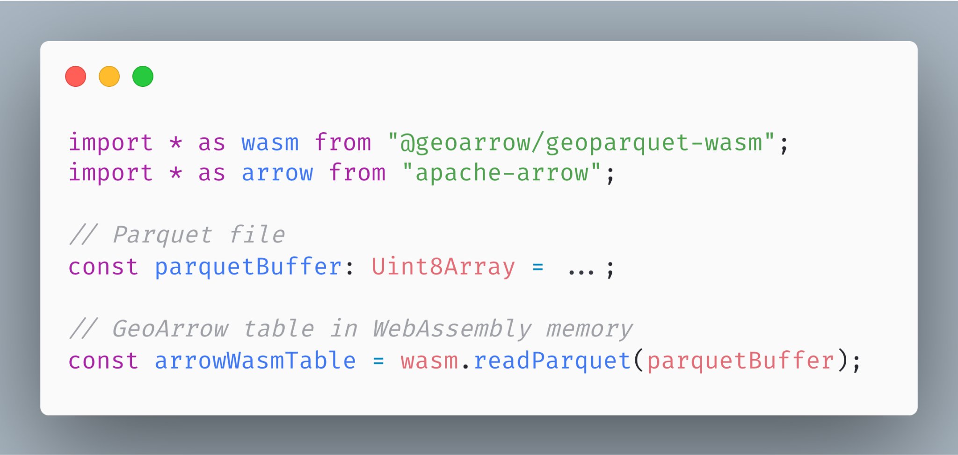
Fast, stable Parquet reading (with WKB parsing)
geoparquet-wasm
Adds Rust implementation of WKB parsing to parquet-wasm
Parses GeoParquet into GeoArrow
Published soon to NPM
Notes:
Motivating the talk in the reverse direction

Slide 23
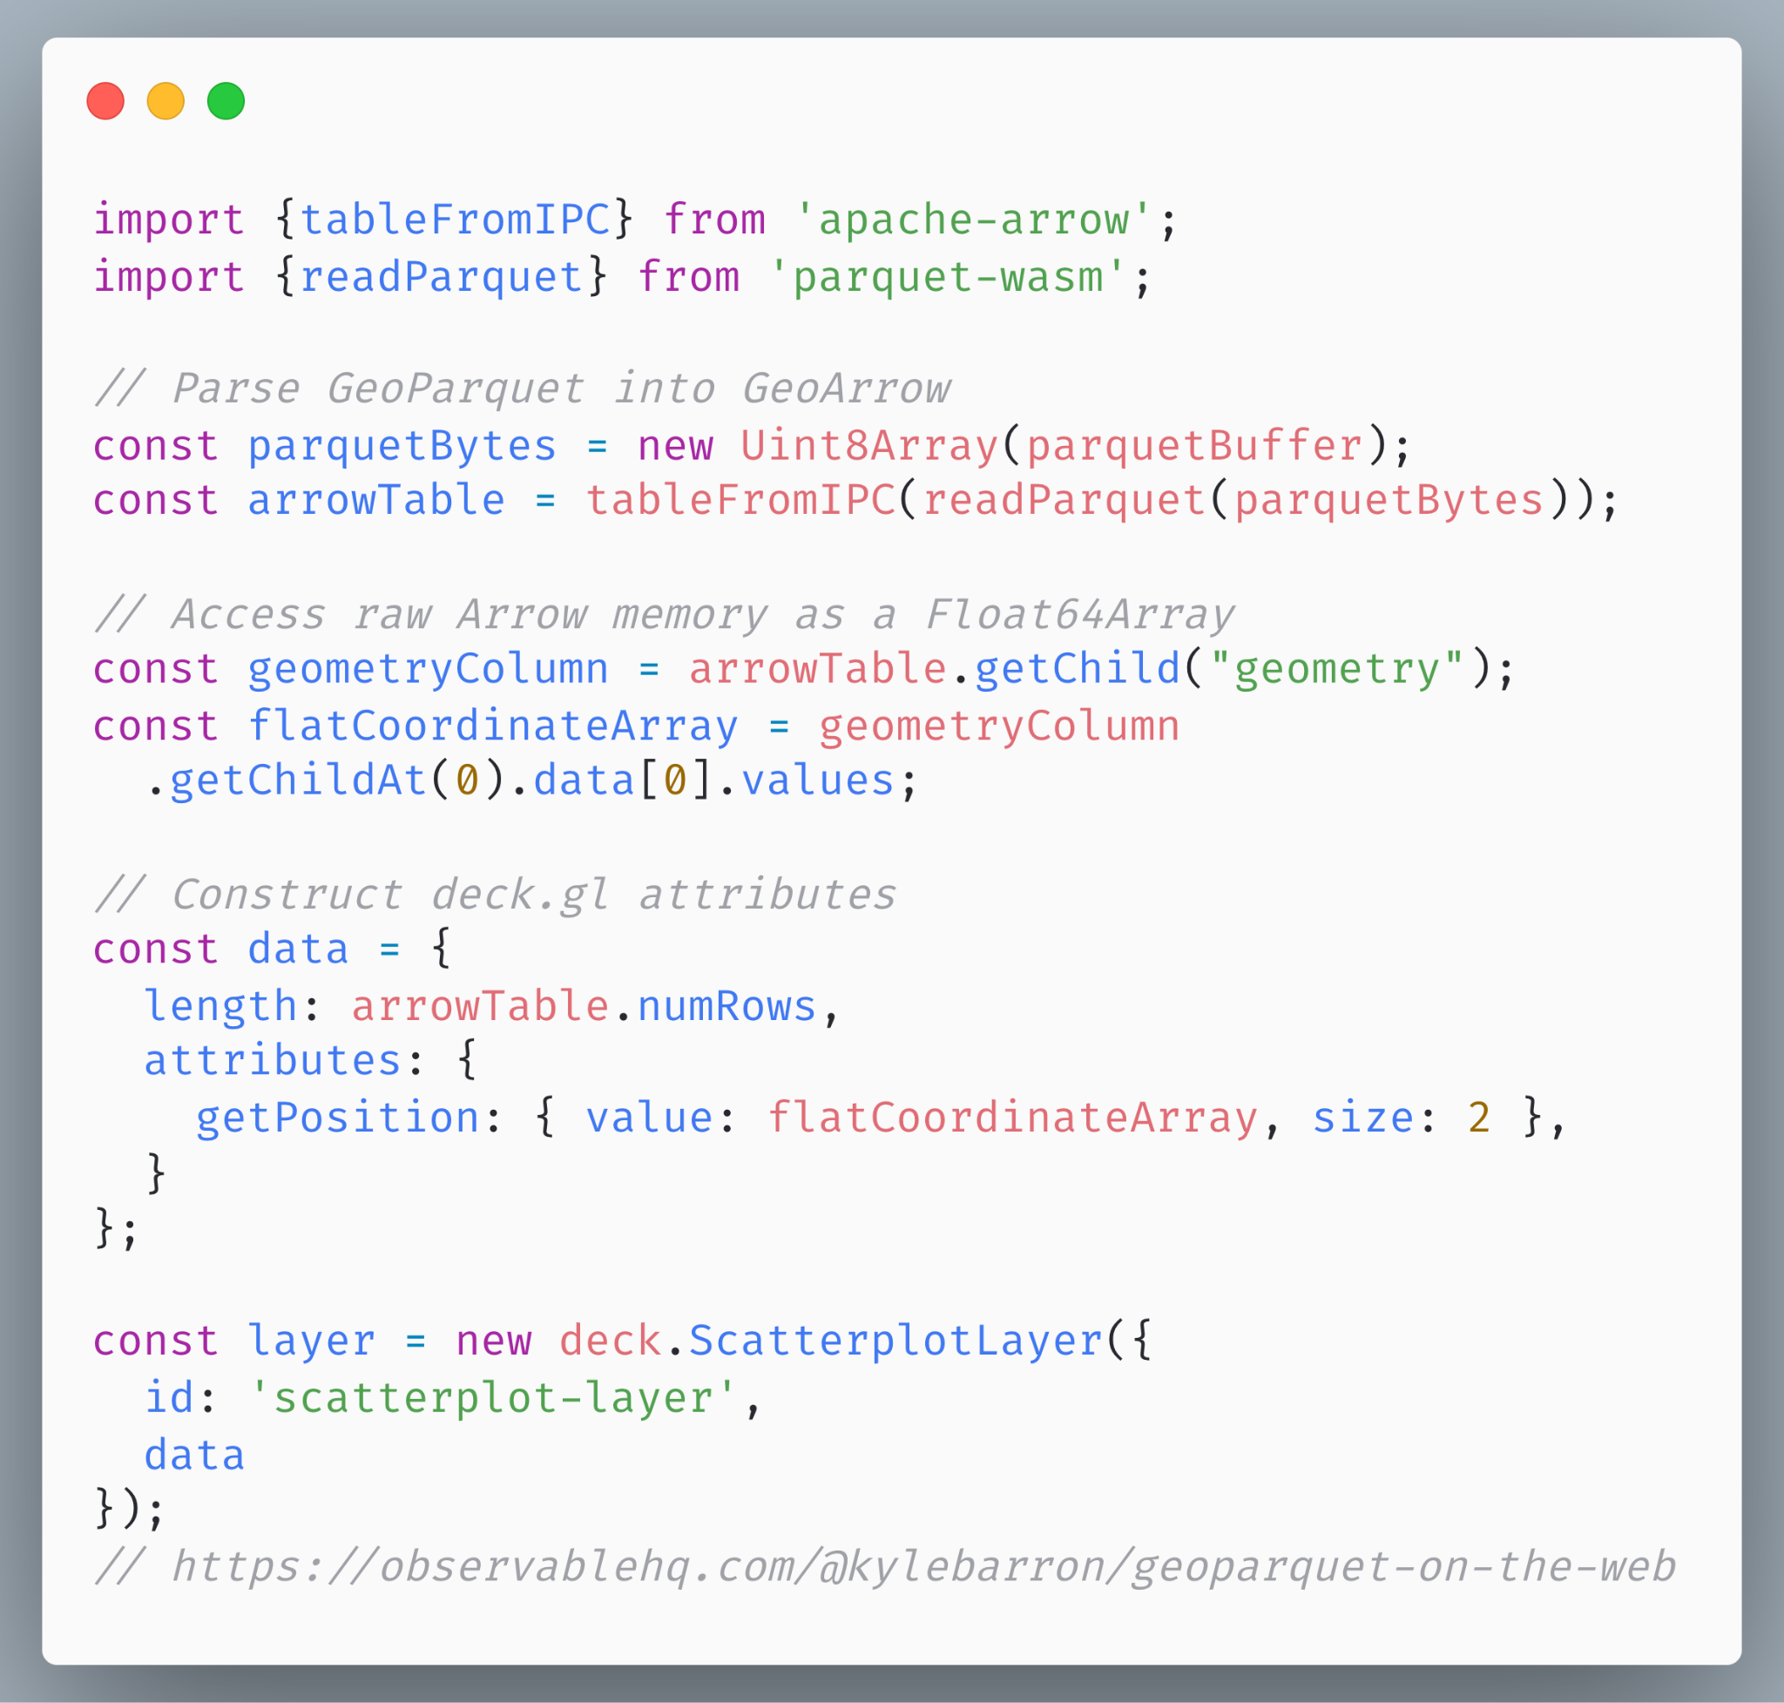
Using the binary API
deck.gl rendering
Pass GeoArrow coordinate buffers into the deck.gl binary API
Notes:
Motivating the talk in the reverse direction

Slide 24
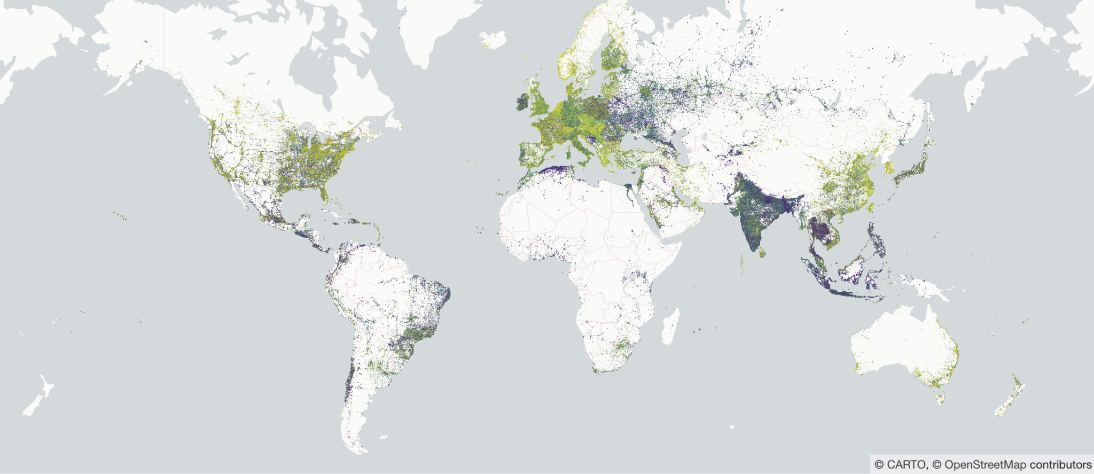
GeoParquet + GeoArrow + deck.gl
It’s really fast!
3.2 million points rendered in deck.gl
https://observablehq.com/@kylebarron/geoparquet-on-the-web
Notes:
Motivating the talk in the reverse direction

Slide 25
GeoArrowLayer
Future work: Usability
Today: requires manually passing buffers into binary API
Tomorrow: GeoArrowLayer
Accept Arrow JS Table or similar; render sub layers automatically
Renders one deck.gl sub layer for each internal chunk
Better integration with picking, styling
Notes:
Motivating the talk in the reverse direction

Slide 26
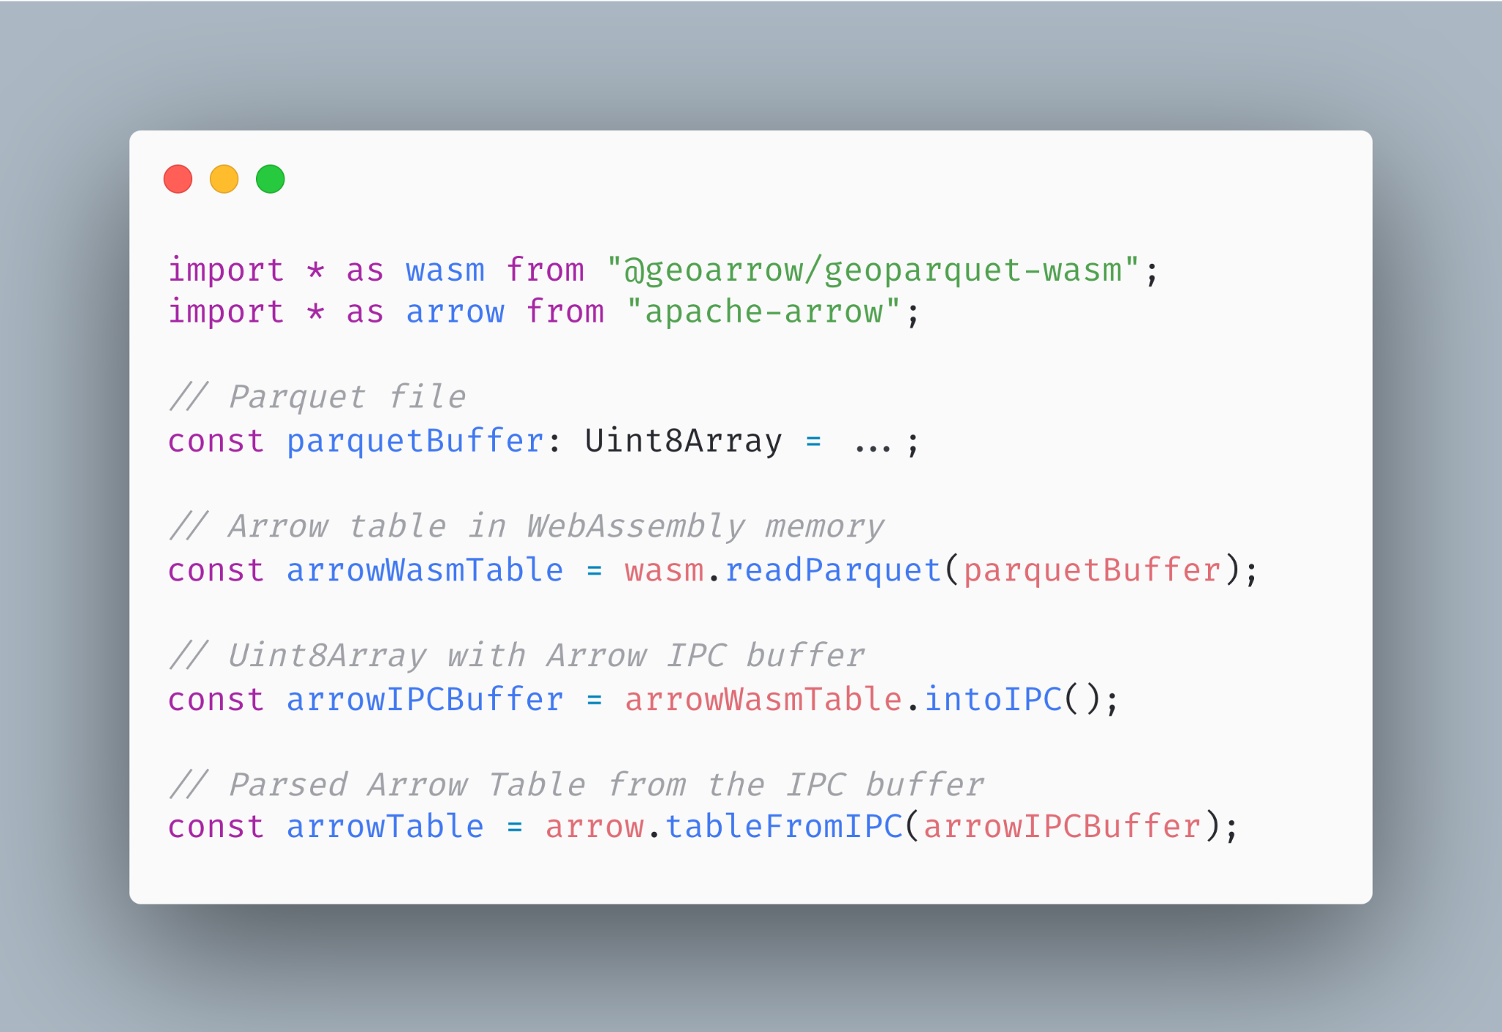
Future work: Performance
Today: copying Arrow from Wasm
Parse Parquet into an Arrow table in WebAssembly memory
Copy the table into Arrow IPC format in WebAssembly memory.
Copy the buffer from WebAssembly memory to JS memory
Parse it on the JS side into an Arrow Table
Step 2 requires materializing a single buffer, pushing peak memory utilization very high.
Notes:
https://carbon.now.sh/aX34XLgwDLy7UREwbWyQ

Slide 27
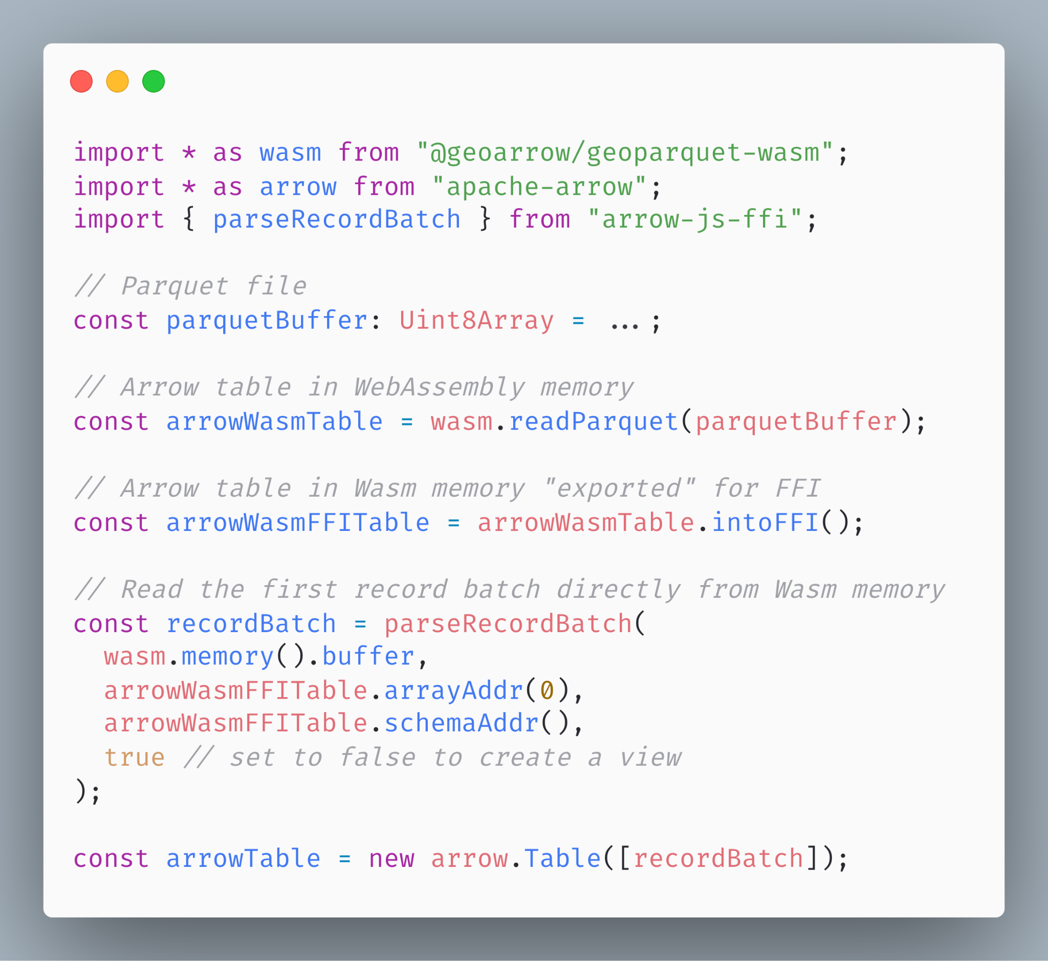
Future work: Performance
Tomorrow: no serialization
Every Arrow implementation has exact same memory layout: no serialization needed
Parse Parquet into an Arrow table in WebAssembly memory
Copy the table into Arrow IPC format in WebAssembly memory.
Copy or view the table directly from WebAssembly memory
Parse it on the JS side into an Arrow Table
Reduces peak memory pressure in Wasm by almost half.
Also possible in some cases to copy directly from Wasm to the GPU
https://github.com/kylebarron/arrow-js-ffi
Notes:
https://carbon.now.sh/aX34XLgwDLy7UREwbWyQ
This means that when the GeoArrow memory format coincides with the binary format deck.gl knows how to interpret, we can render geometries copying directly from WebAssembly to the GPU!.
This is error prone and should be used very carefully (e.g. if the Wasm memory space grows, your views get broken), so I recommend most users to copy these arrays into JS. But this is still much more memory efficient than constructing an IPC buffer.

Slide 28
Enabling zero-copy data sharing for geospatial
Future work: Bundle size
I’ve started to explore library for very minimal Arrow array definitions
Complementary to & ABI-compatible with Arrow JS, useful for getting data in and out of Wasm
A GeoArrowLayer could possibly avoid hard dependency on Arrow JS
Notes:
Motivating the talk in the reverse direction

Slide 29
kylebarron
kylebarron2
kylebarrongeo

